Slide 1
Improving GP-UCB Algorithm by Harnessing Decomposed Feedback
Kai Wang, Bryan Wilder, Sze-chuan Suen, Milind Tambe, Bistra Dilkina

Slide 2
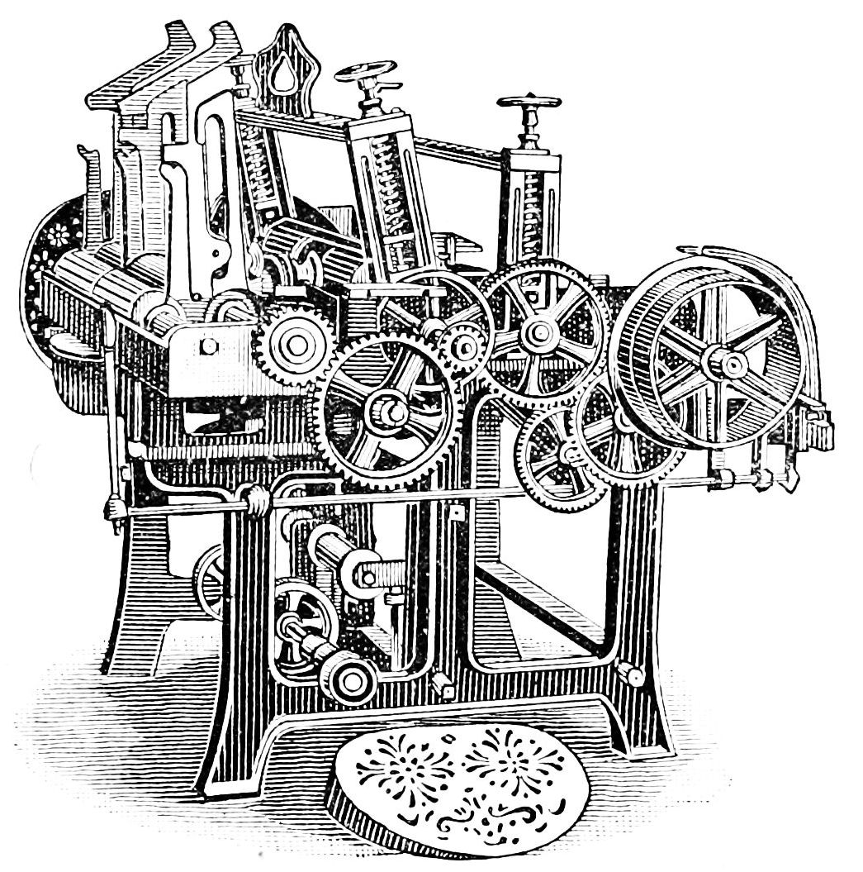


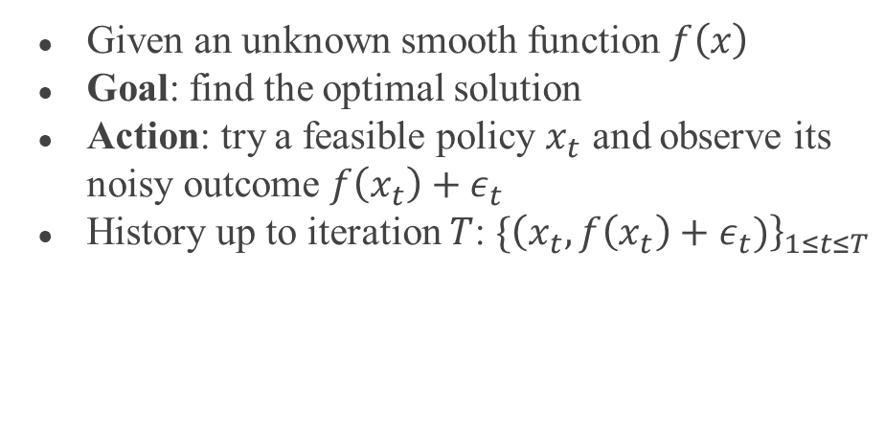
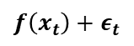
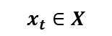
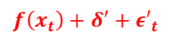
Blackbox Optimization
$$x_{t}+δ∈X$$
$$x_{t}∈X$$
Given an unknown smooth function $f\left(x\right)$
Goal: find the optimal solution
Action: try a feasible policy $x_{t}$ and observe its noisy outcome $f\left(x_{t}\right)+ε_{t}$
History up to iteration $T$: $\{{\left(x_{t}, f\left(x_{t}\right)+ε_{t})\right\}}_{1≤t≤T}$
$$f$$
How?
Gaussian Process Regression!!
$$f\left(x_{t}\right)+ε_{t}$$
$$f\left(x_{t}\right)+δ′+{ε′}_{t}$$

Slide 3
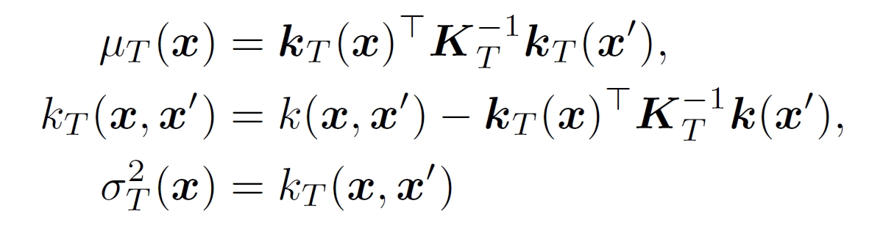
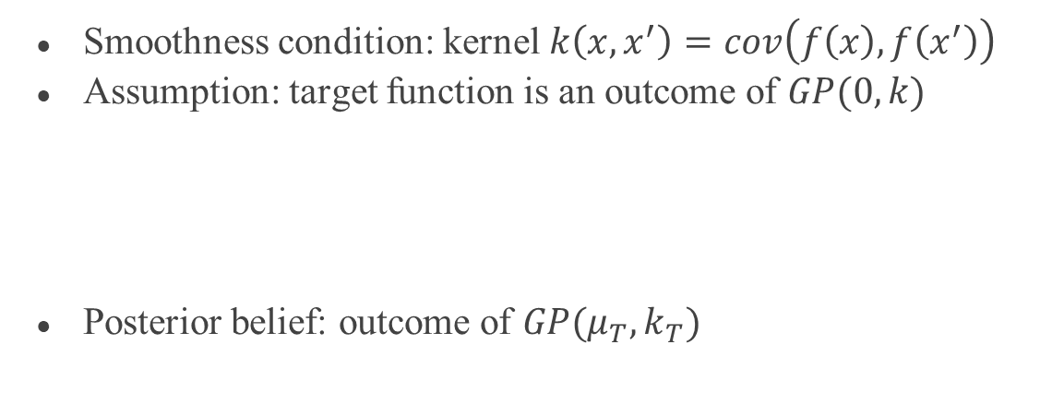
Gaussian Process Regression
Smoothness condition: kernel $k\left(x,x^{′}\right)=cov\left(f\left(x\right),f\left(x^{′}\right)\right)$
Assumption: target function is an outcome of $GP(0,k)$
Posterior belief: outcome of $GP(μ_{T}, k_{T})$

Slide 4
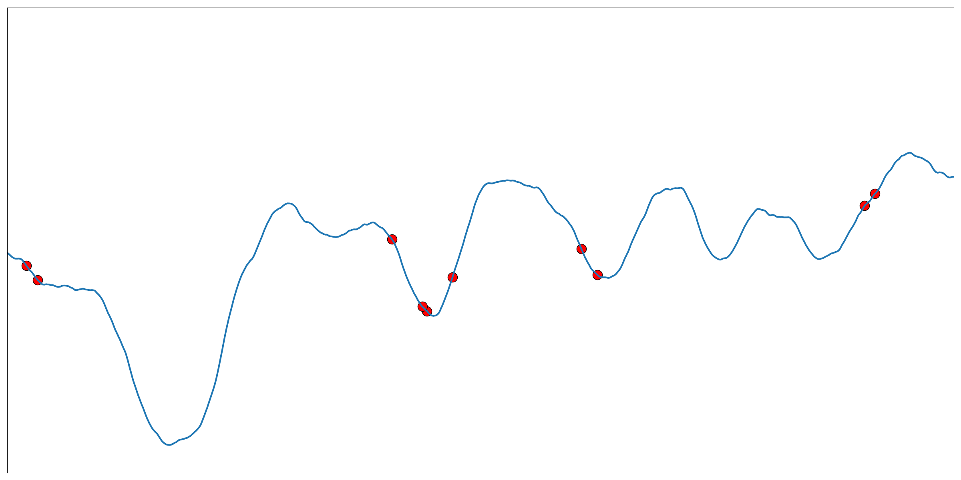
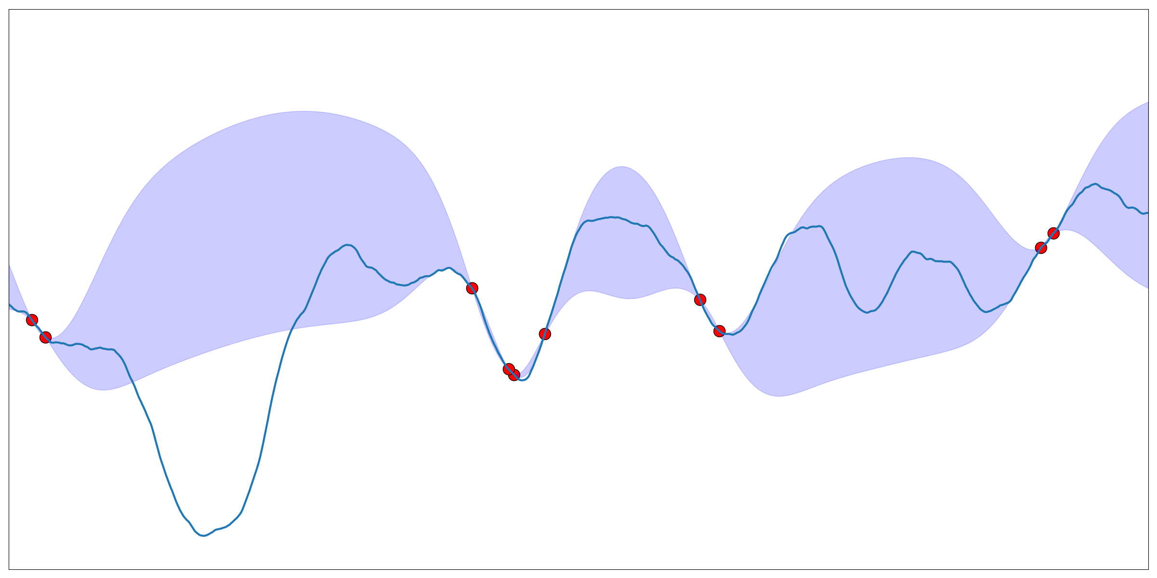
Gaussian Process Regression

Slide 5



Multi-arm Bandit problem
A special kind of online learning problem
Exploration v.s. Exploitation
0.2
0.8
0.5

Slide 6
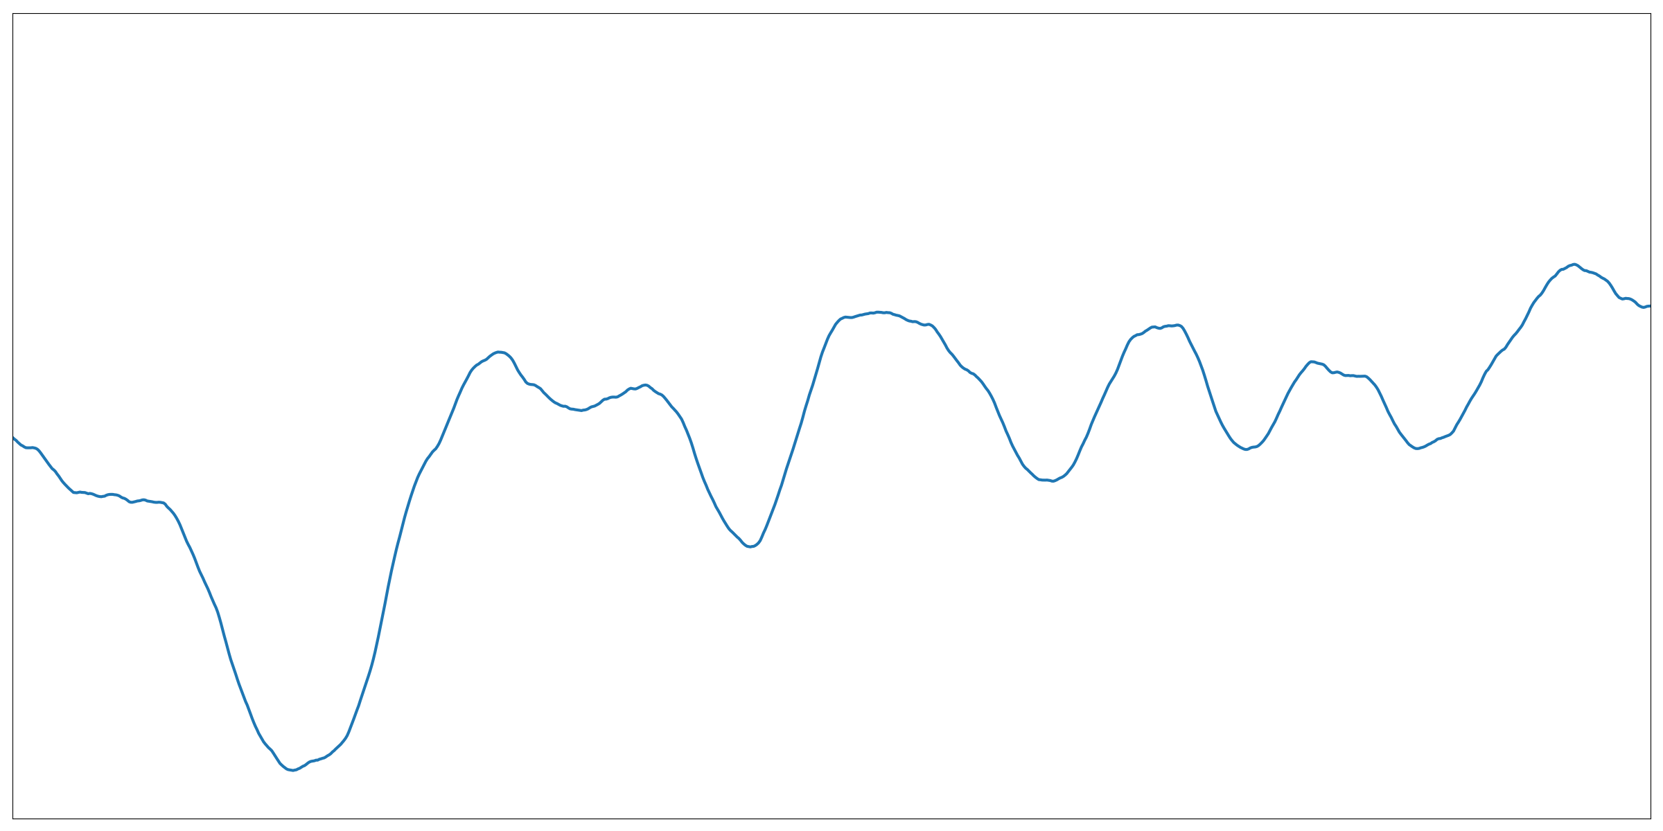
Multi-arm Bandit problem

Slide 7
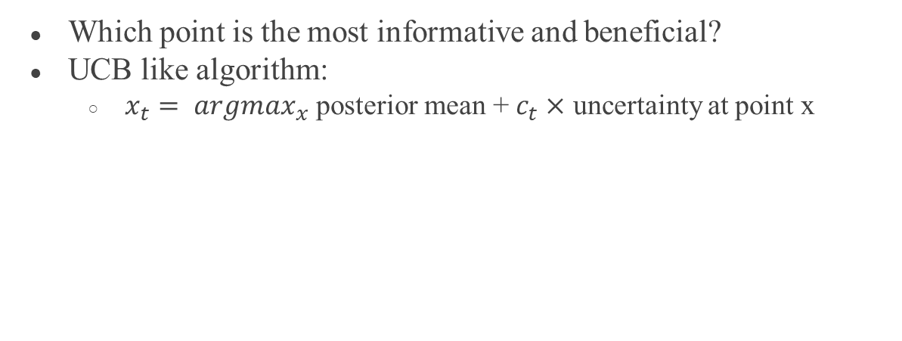
Blackbox Optimization
Which point is the most informative and beneficial?
UCB like algorithm:
$x_{t}= argmax_{x}$ posterior mean + $c_{t}×$ uncertainty at point x
Exploration
Exploitation

Slide 8
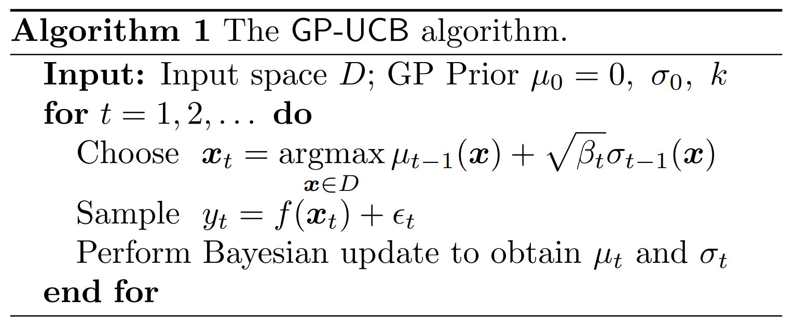
GP-UCB
Niranjan Srinivas, Andreas Krause, Sham M. Kakade, Matthias Seeger. “Gaussian Process Optimization in the Bandit Setting: No Regret and Experimental Design”

Slide 9
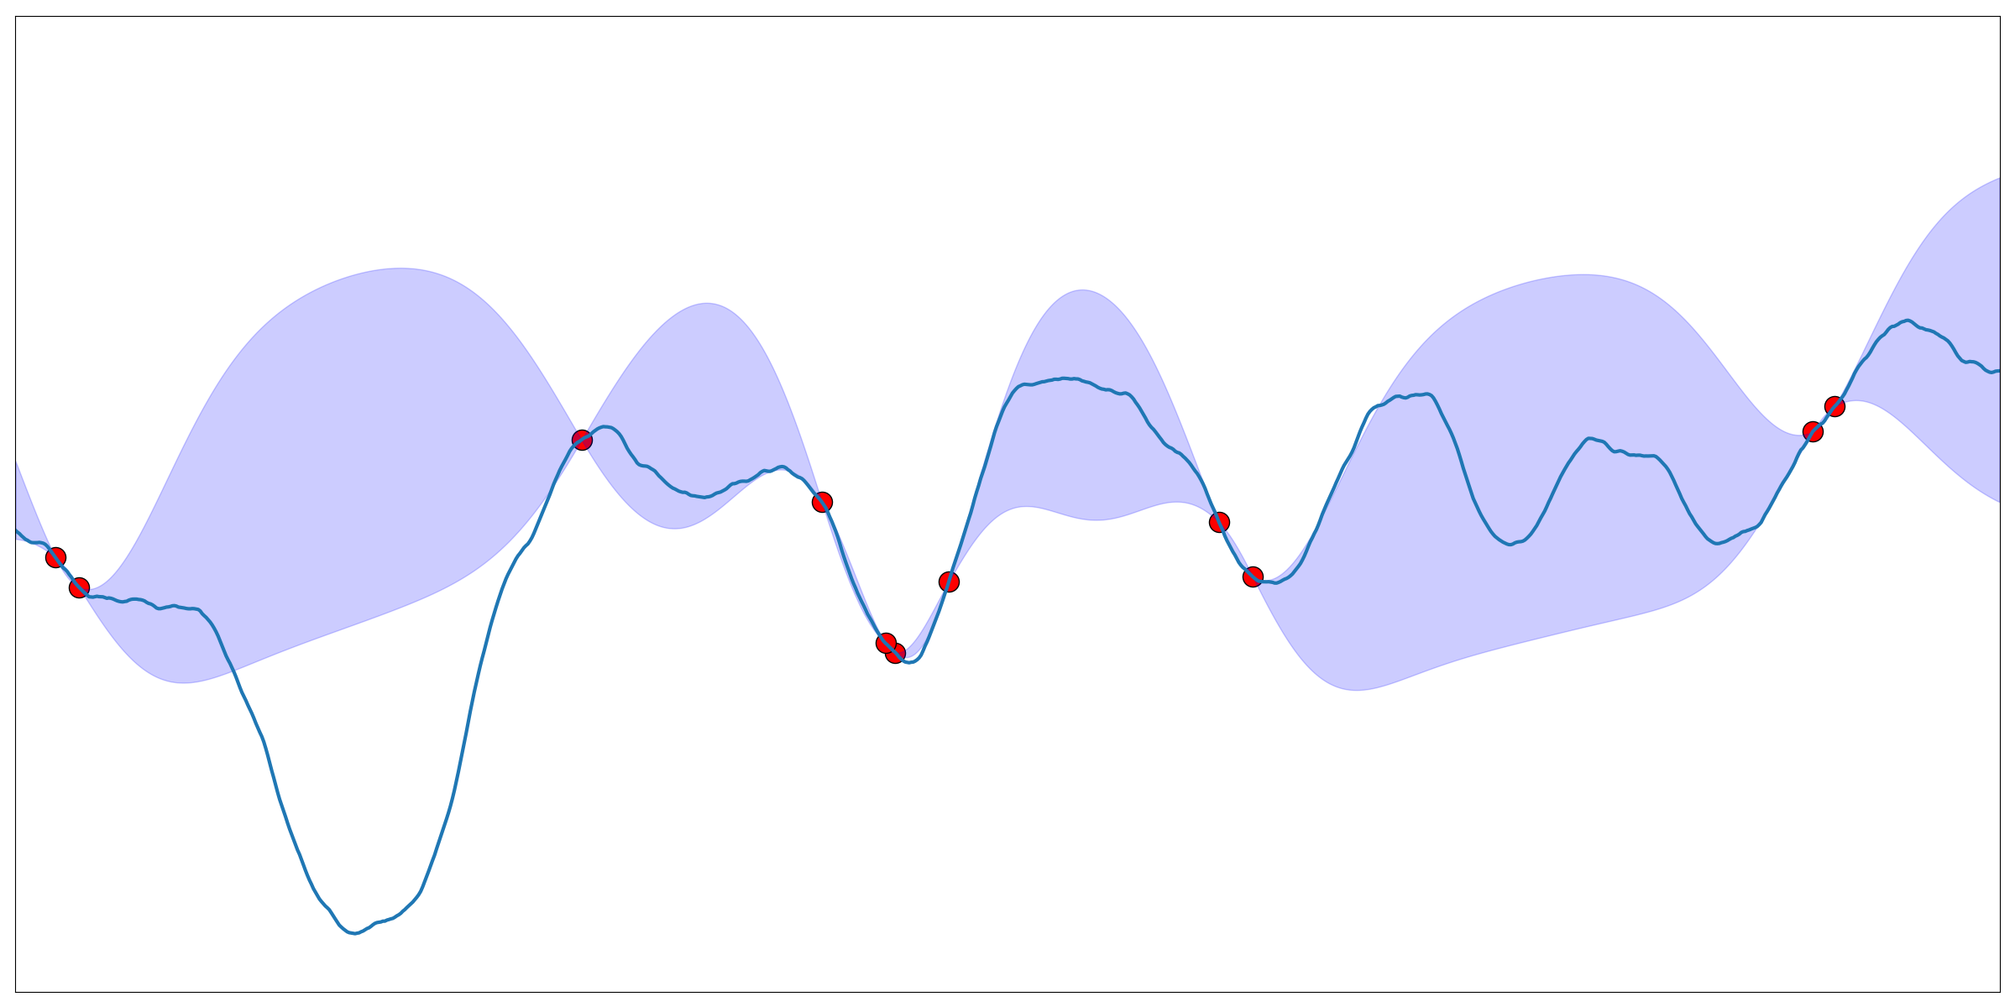
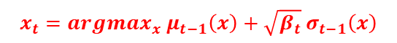
GP-UCB
$$x_{t}=argmax_{x} μ_{t−1}\left(x\right)+\sqrt{β_{t}} σ_{t−1}\left(x\right)$$
Niranjan Srinivas, Andreas Krause, Sham M. Kakade, Matthias Seeger. Gaussian Process Optimization in the Bandit Setting: No Regret and Experimental Design. ICML 2010

Slide 10
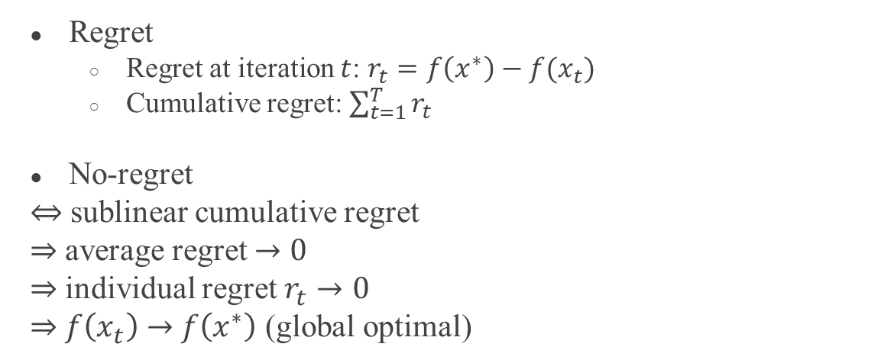
No-regret Property
Regret
Regret at iteration $t$: $r_{t}=f\left(x^{∗}\right)−f(x_{t})$
Cumulative regret: $\sum_{t=1}^{T}{r_{t}}$
No-regret
$⇔$ sublinear cumulative regret
$⇒$ average regret $→0$
$⇒$ individual regret $r_{t}$ $→0$
$⇒$ $f\left(x_{t}\right)$ $→$ $f\left(x^{∗}\right)$ (global optimal)

Slide 11

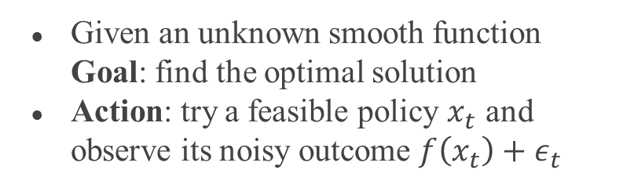
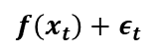
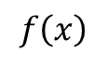
Blackbox Optimization
Given an unknown smooth function Goal: find the optimal solution
Action: try a feasible policy $x_{t}$ and observe its noisy outcome $f\left(x_{t}\right)+ε_{t}$
$$f\left(x\right)$$
$$f$$
$$x_{t}∈X$$
$$f\left(x_{t}\right)+ε_{t}$$

Slide 12
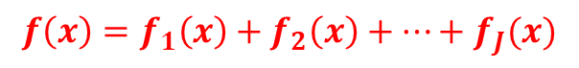
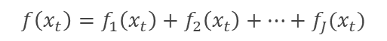
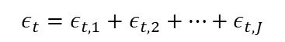
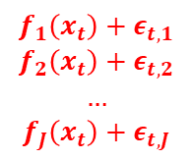
Blackbox Optimization
Given an unknown smooth function Goal: find the optimal solution
Action: try a feasible policy $x_{t}$ and observe its noisy outcome $f\left(x_{t}\right)+ε_{t}$
$$f\left(x\right)=f_{1}\left(x\right)+f_{2}\left(x\right)+…+f_{J}(x)$$
$$f$$
$$x_{t}∈X$$
$$f\left(x_{t}\right)+ε_{t}$$
$$f\left(x_{t}\right)=f_{1}\left(x_{t}\right)+f_{2}\left(x_{t}\right)+…+f_{J}(x_{t})$$
$$f_{1}\left(x_{t}\right)+ε_{t,1}$$
$$f_{2}\left(x_{t}\right)+ε_{t,2}$$
$$…$$
$$f_{J}\left(x_{t}\right)+ε_{t,J}$$
$$ε_{t}=ε_{t,1}+ε_{t,2}+…+ε_{t,J}$$

Slide 13
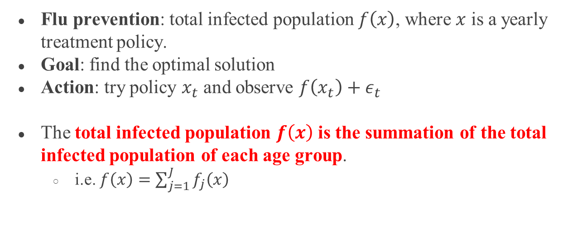
Motivation: Flu Prevention
Flu prevention: total infected population $f\left(x\right)$, where $x$ is a yearly treatment policy.
Goal: find the optimal solution
Action: try policy $x_{t}$ and observe $f\left(x_{t}\right)+ε_{t}$
The total infected population $f\left(x\right)$ is the summation of the total infected population of each age group.
i.e. $f\left(x\right)=\sum_{j=1}^{J}{f_{j}\left(x\right)}$

Slide 14
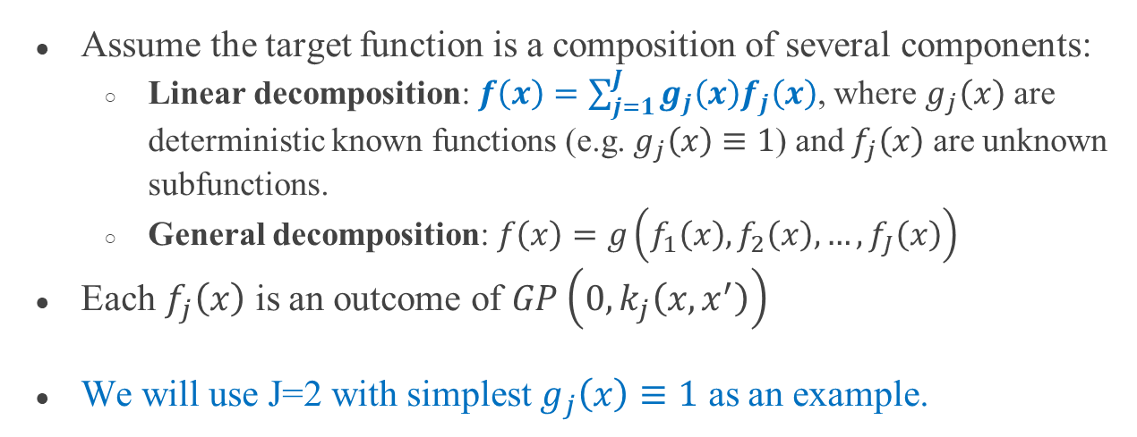
Decomposition
Assume the target function is a composition of several components:
Linear decomposition: $f\left(x\right)=\sum_{j=1}^{J}{g_{j}\left(x\right)f_{j}\left(x\right)}$, where $g_{j}\left(x\right)$ are deterministic known functions (e.g. $g_{j}\left(x\right)≡1$) and $f_{j}\left(x\right)$ are unknown subfunctions.
General decomposition: $f\left(x\right)=g\left(f_{1}\left(x\right), f_{2}\left(x\right),…,f_{J}\left(x\right)\right)$
Each $f_{j}\left(x\right)$ is an outcome of $GP\left(0, k_{j}\left(x,x^{′}\right)\right)$
We will use J=2 with simplest $g_{j}\left(x\right)≡1$ as an example.

Slide 15
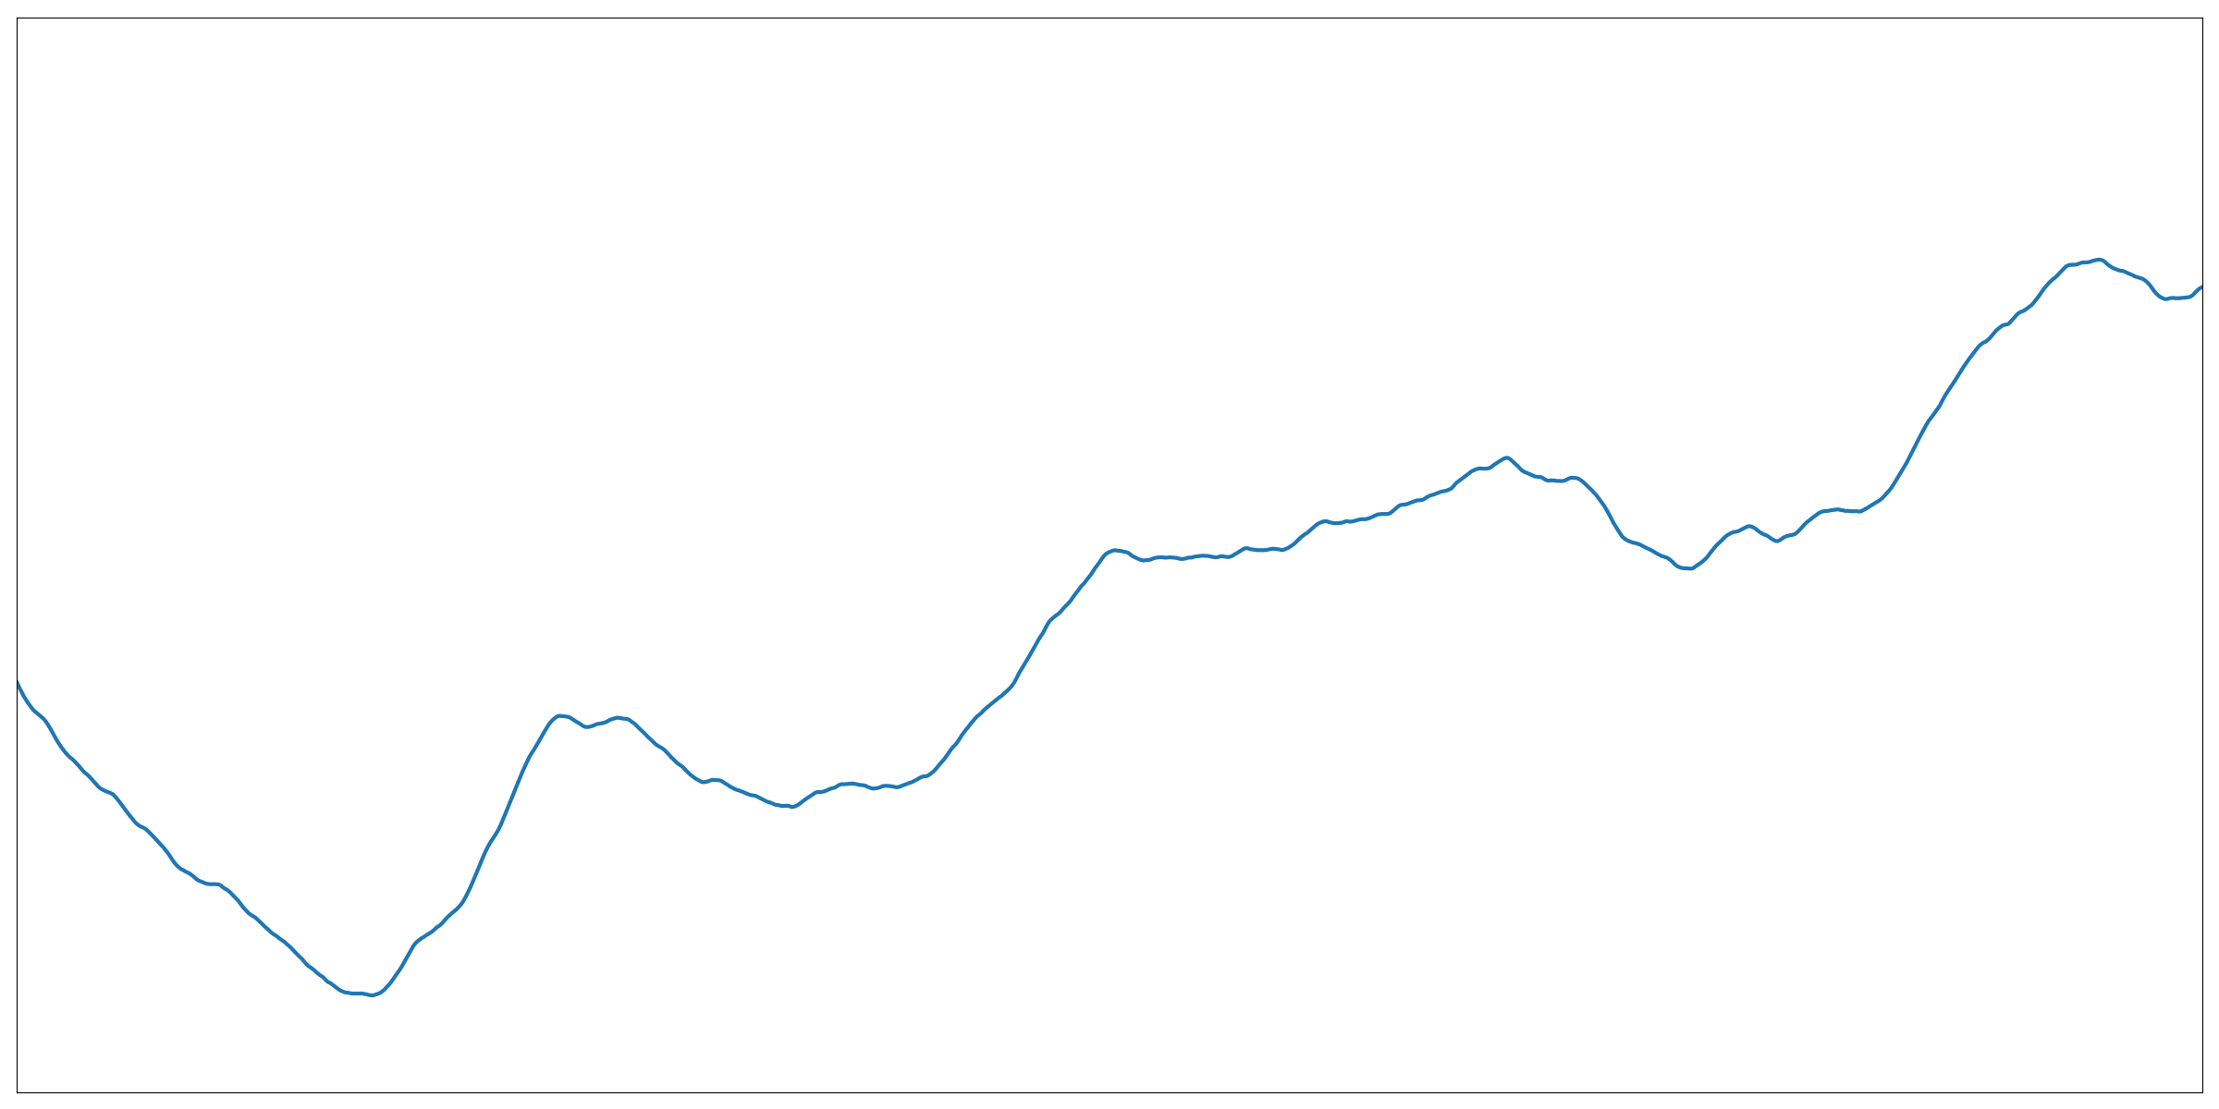
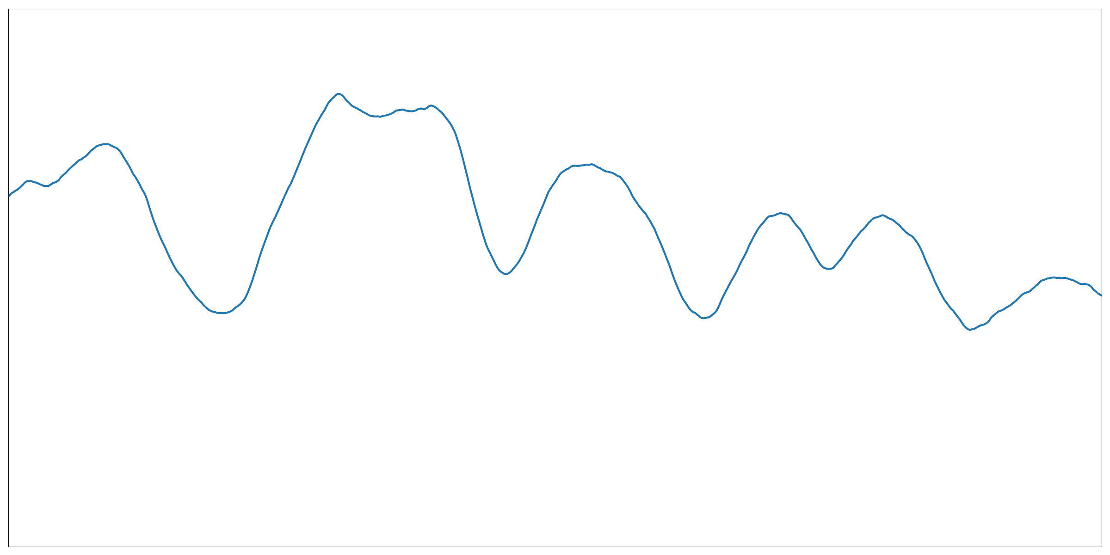



Decomposed GP Regression
$$f_{1}$$
$$f$$
=
+
$$f_{2}$$

Slide 16
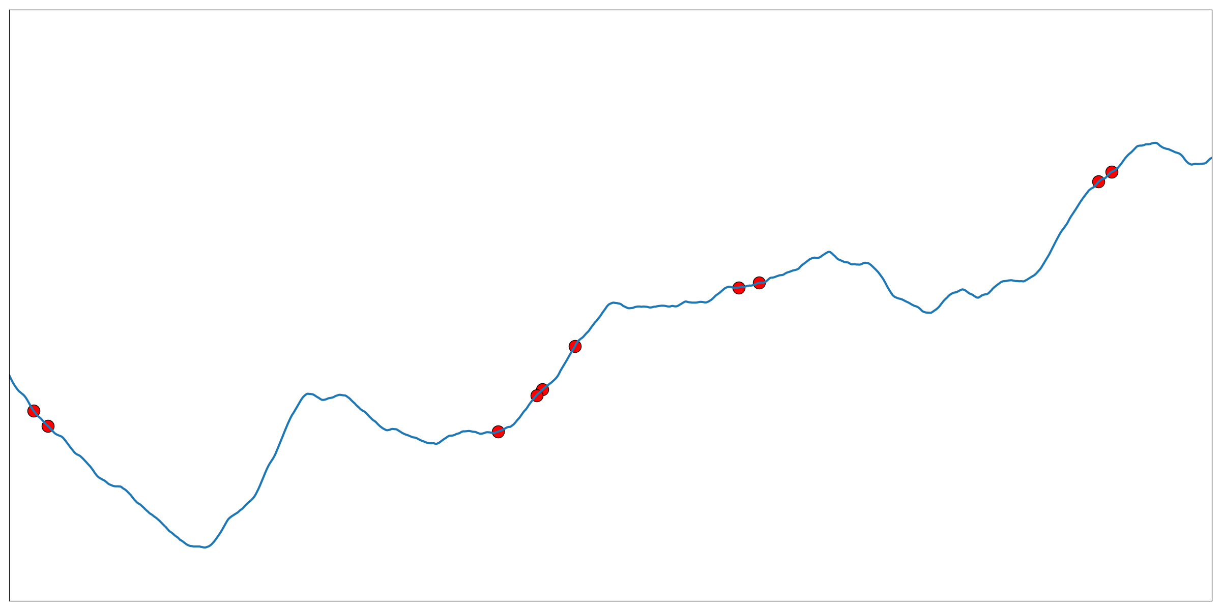
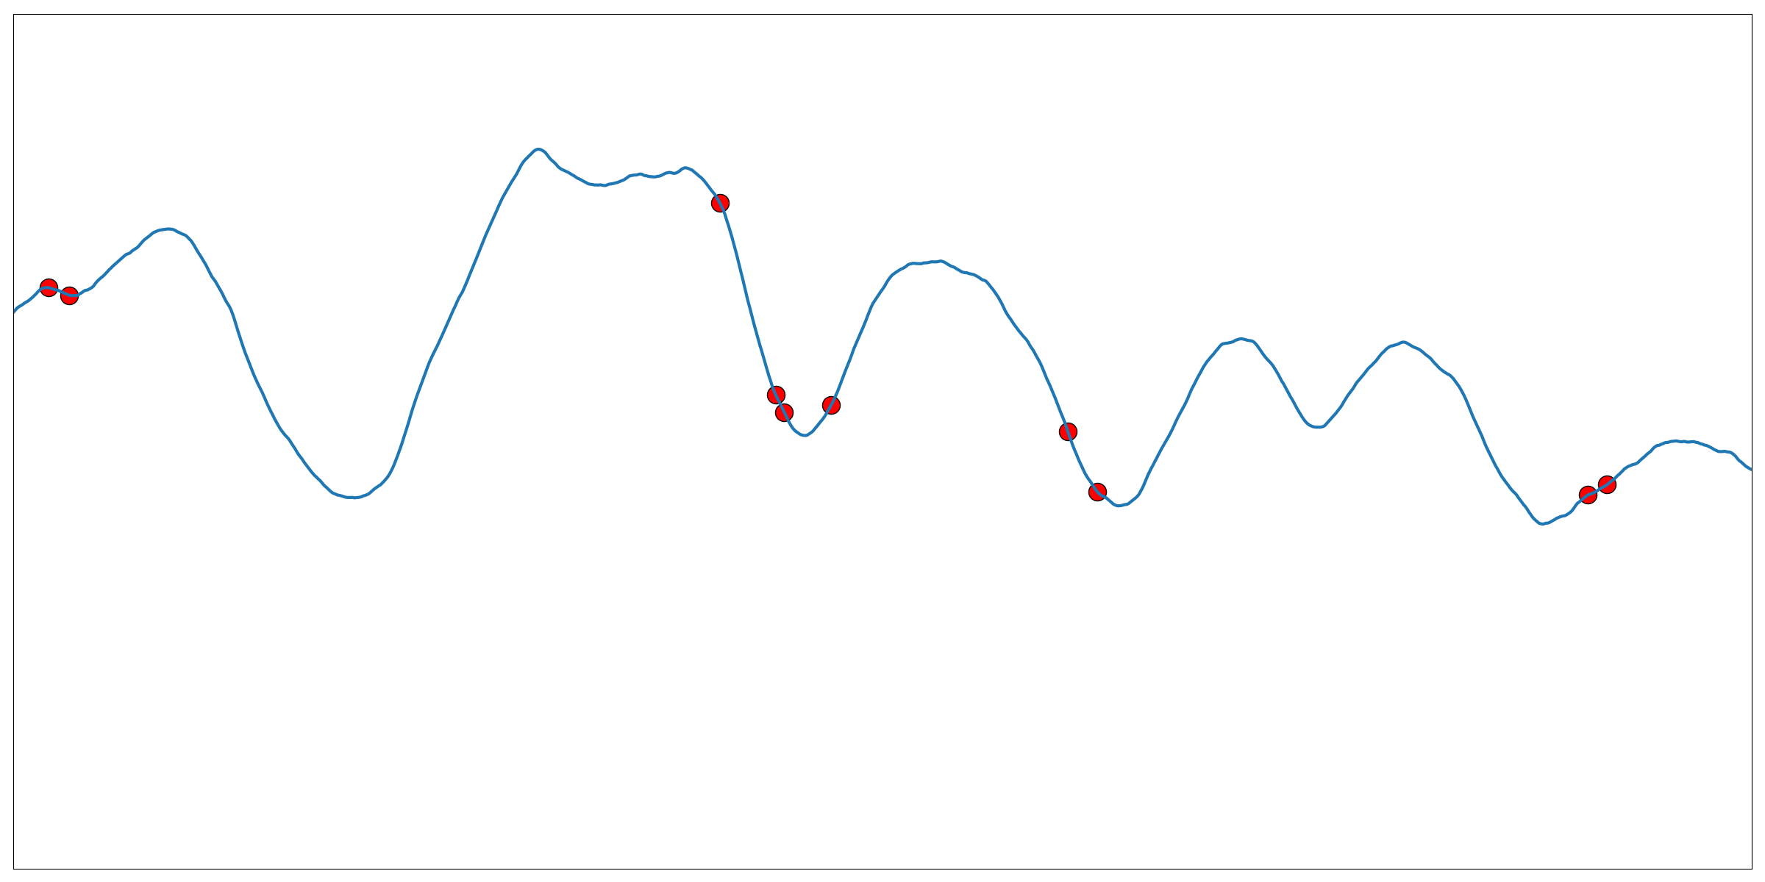
Decomposed GP Regression
$$f_{1}$$
$$f$$
=
+
$$f_{2}$$

Slide 17
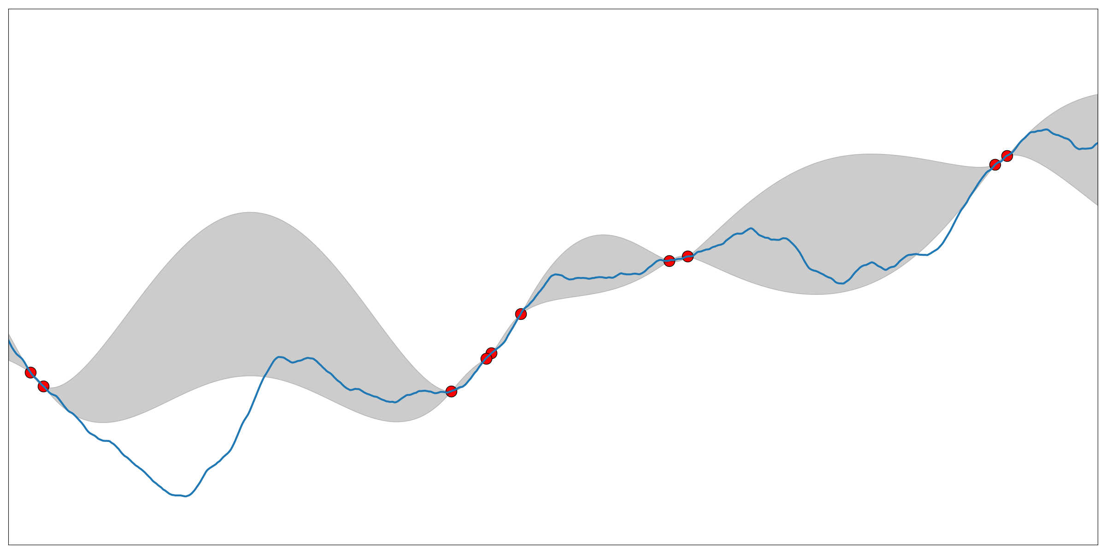
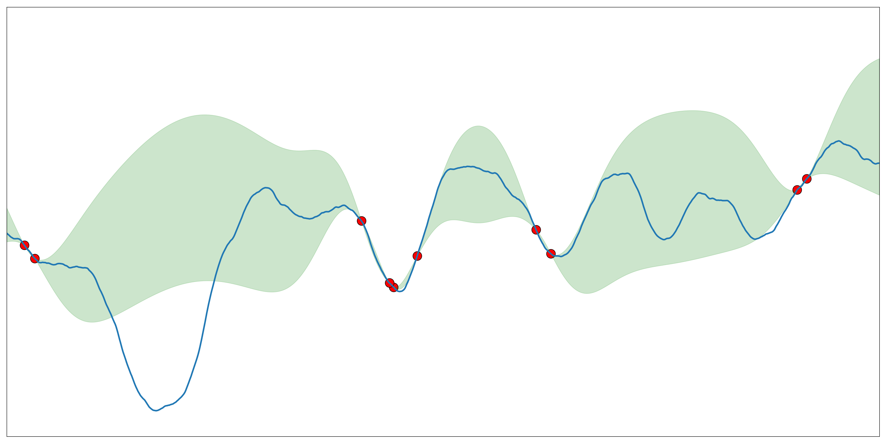
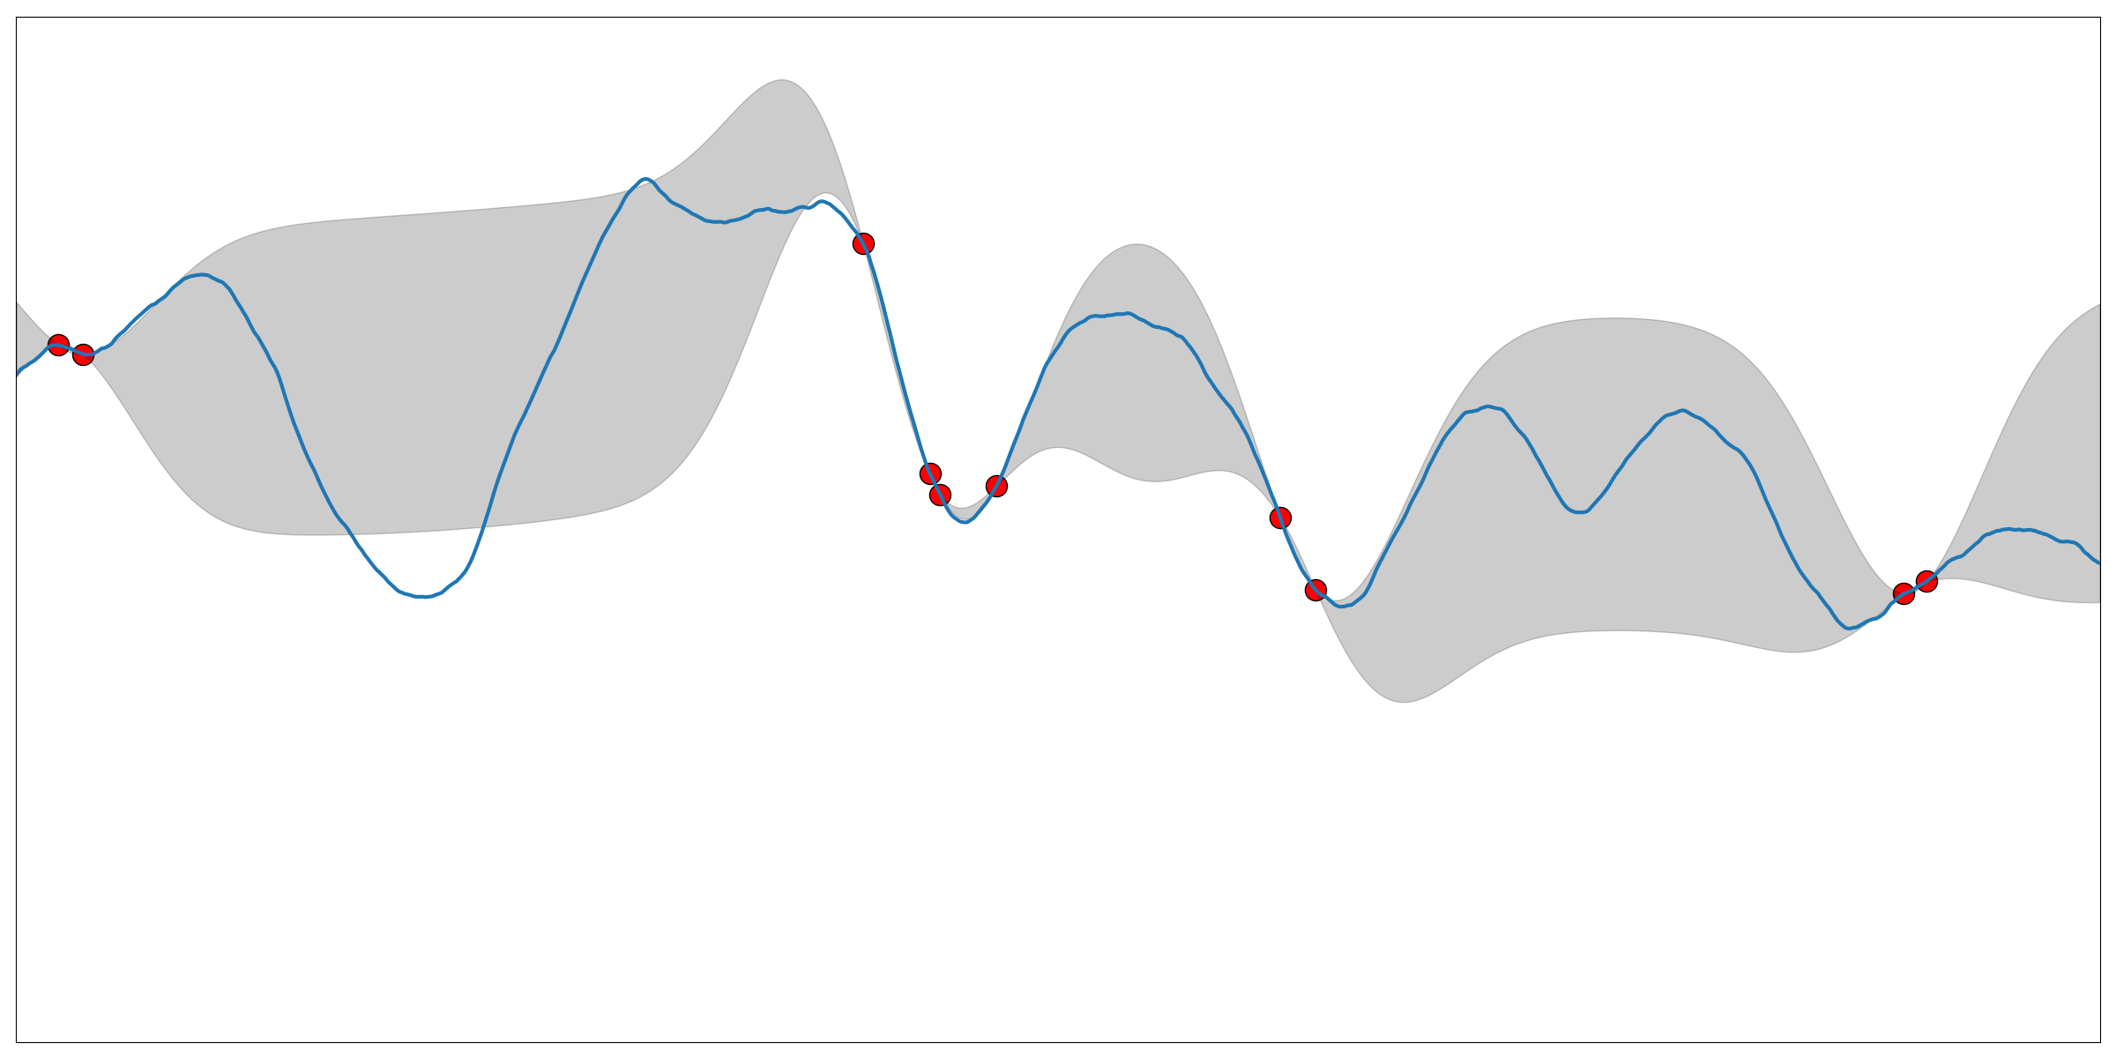
Decomposed GP Regression
$$f_{1}$$
$$f$$
=
+
$$f_{2}$$

Slide 18
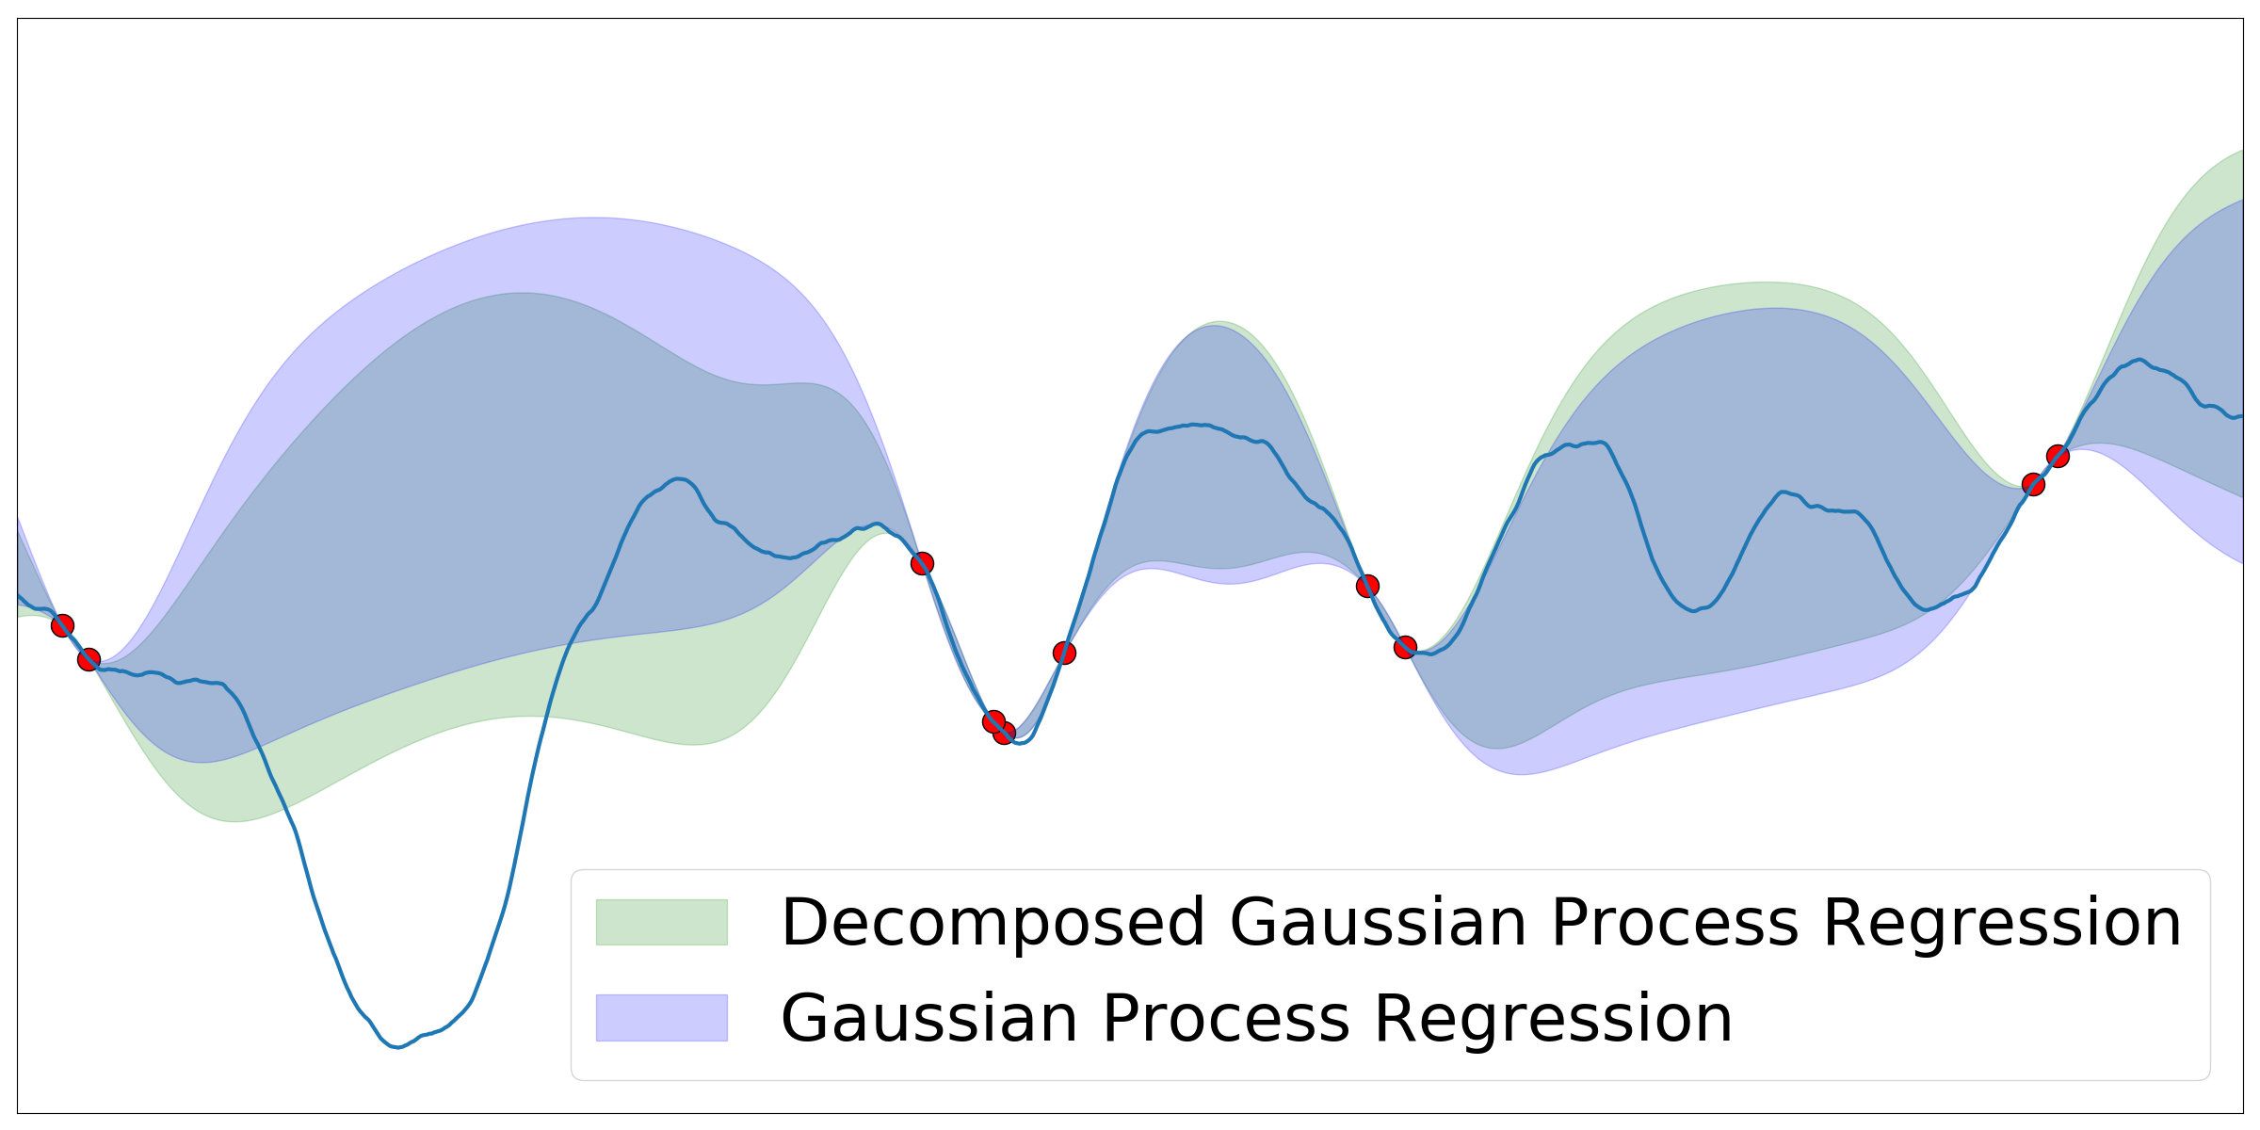
Decomposed GP Regression

Slide 19
Reduced Variance
Theorem: the uncertainty (variance) returned by decomposed GP regression is no greater than the uncertainty returned by GP regression.

Slide 20
How about the GP-UCB algorithm?
Can we apply this new regression to GP-UCB algorithm?

Slide 21
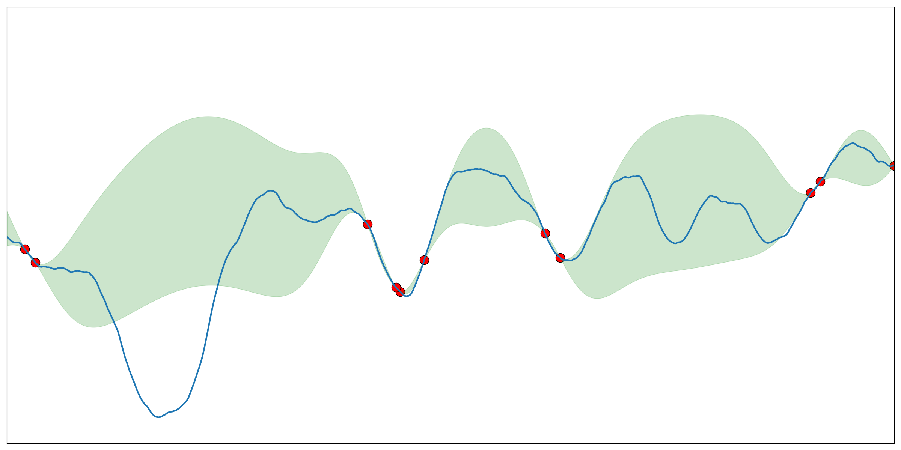
Decomposed GP-UCB (D-GPUCB)

Slide 22
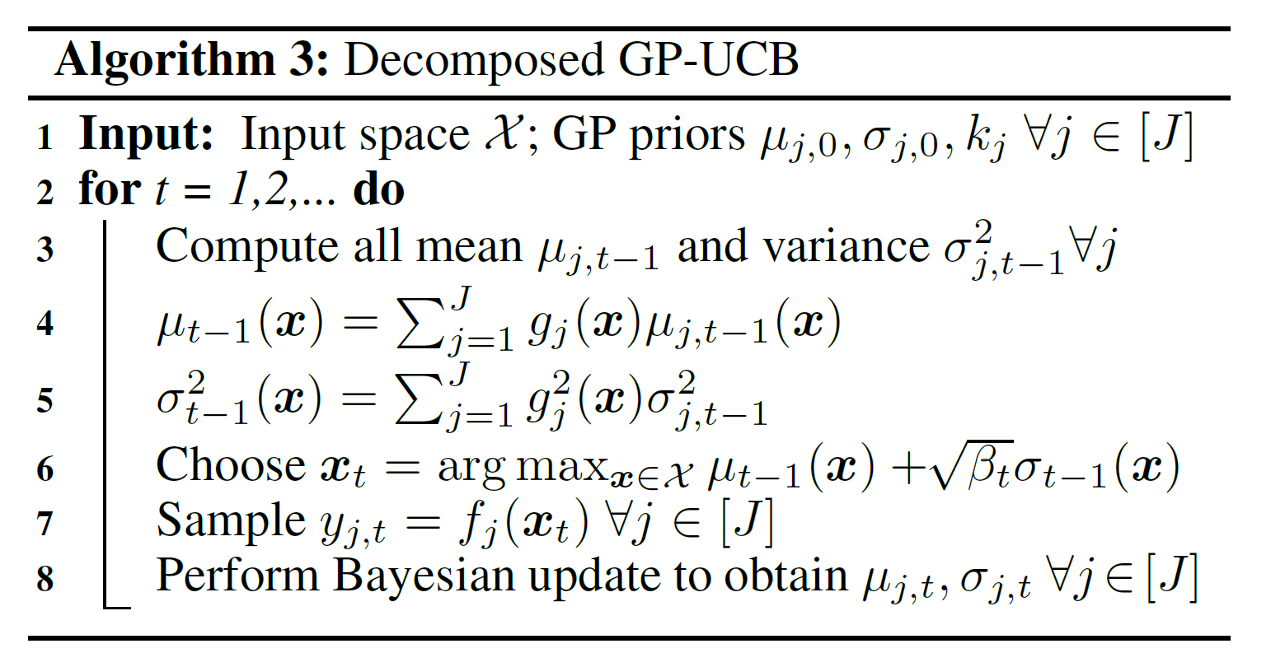
Decomposed GP-UCB (D-GPUCB)

Slide 23
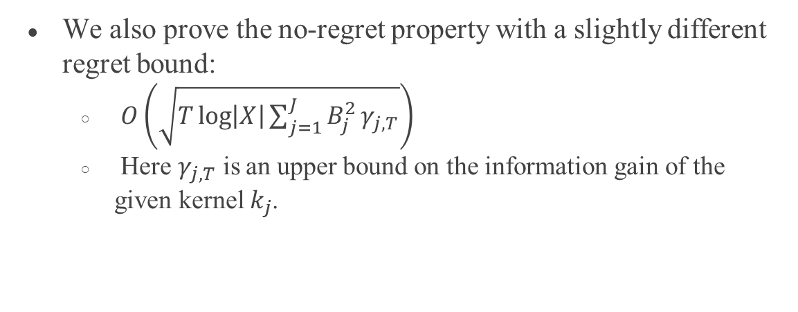
No-regret Property of D-GPUCB
We also prove the no-regret property with a slightly different regret bound:
$O\left(\sqrt{T\log\left|X\right|\sum_{j=1}^{J}{B_{j}^{2}}γ_{j,T}}\right)$
Here $γ_{j,T}$ is an upper bound on the information gain of the given kernel $k_{j}$.

Slide 24
Comparison: Qualitatively
At each iteration, we get a slightly better regression. Therefore, in the end we should be able to see a better convergent rate.

Slide 25
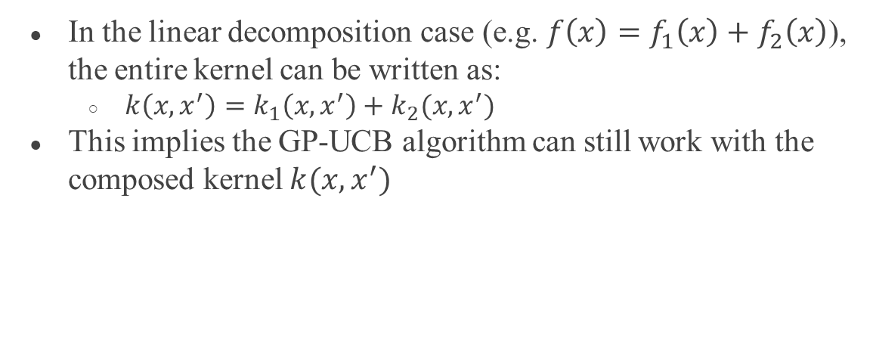
Comparison: Quantitively
In the linear decomposition case (e.g. $f\left(x\right)=f_{1}\left(x\right)+f_{2}\left(x\right)$), the entire kernel can be written as:
$k\left(x,x^{′}\right)=k_{1}\left(x,x^{′}\right)+k_{2}(x,x^{′})$
This implies the GP-UCB algorithm can still work with the composed kernel $k(x,x^{′})$

Slide 26
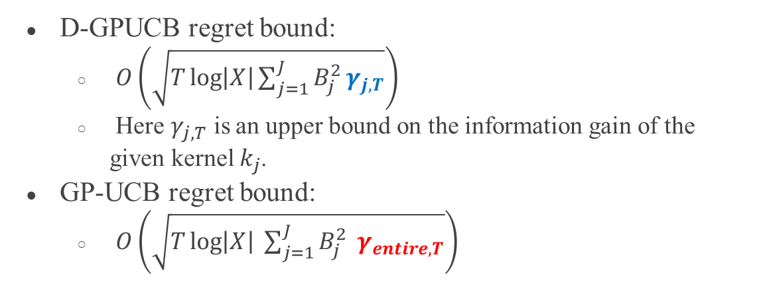
Comparison: Quantitively
D-GPUCB regret bound:
$O\left(\sqrt{T\log\left|X\right|\sum_{j=1}^{J}{B_{j}^{2}}γ_{j,T}}\right)$
Here $γ_{j,T}$ is an upper bound on the information gain of the given kernel $k_{j}$.
GP-UCB regret bound:
$O\left(\sqrt{T\log\left|X\right| \sum_{j=1}^{J}{B_{j}^{2}} γ_{entire, T}}\right)$

Slide 27
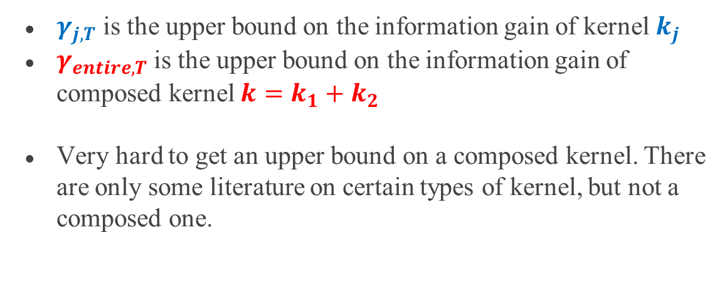
Comparison: Quantitively
$γ_{j, T}$ is the upper bound on the information gain of kernel $k_{j}$
$γ_{entire, T}$ is the upper bound on the information gain of composed kernel $k=k_{1}+k_{2}$
Very hard to get an upper bound on a composed kernel. There are only some literature on certain types of kernel, but not a composed one.

Slide 28
Experimental Results of D-GPUCB
Synthetic function with square exponential kernel and J=10
Flu prevention using SIR model with real data and J=5
Comparison of cumulative regret on D-GPUCB, GPUCB, and two heuristic methods EI, MPI.

Slide 29
Experimental Results of Decomposed GP Regression
Square exponential kernel
Matern kernel
Average improvement (%) in terms of root-mean-square error (RMSE) to the target function.

Slide 30
Conclusion
Decomposed GP regression outperforms GP regression.
D-GPUCB also achieves no-regret property.
D-GPUCB outperforms GP-UCB in both synthetic and real data empirically.
D-GPUCB also works in the general decomposition case (not covered here) and achieves no-regret property under certain condition.

Slide 31
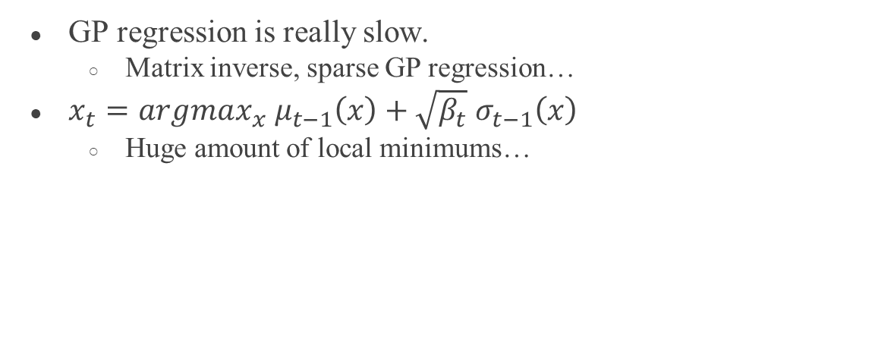
Computational Challenges
GP regression is really slow.
Matrix inverse, sparse GP regression…
$x_{t}=argmax_{x} μ_{t−1}\left(x\right)+\sqrt{β_{t}} σ_{t−1}\left(x\right)$
Huge amount of local minimums…

Slide 32
Future Work
Decomposed GP regression can be applied to most of the Bayesian optimization problem, including expected improvement (EI) and most probable improvement (MPI).
How about methods other than GP?
Unknown kernel in reproducing kernel Hilbert space (RKHS): Srinivas et. al. proved a regret bound in this case, although the bound is usually too pessimistic.

Slide 33
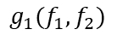
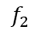
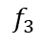
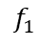
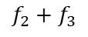
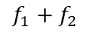
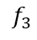
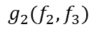
Crazy Idea
Linear composition of GP outcomes is still a GP outcome
General composition of GP outcomes is not a GP outcome
But D-GPUCB still works under general composition…
GP-UCB
D-GPUCB
$$f_{2}$$
$$f_{2}$$
$$f_{1}$$
$$f_{3}$$
$$f_{1}$$
$$f_{3}$$
$$f_{1}+f_{2}$$
$${g_{1}(f}_{1},f_{2})$$
$$f_{2}+f_{3}$$
$${g_{2}(f}_{2},f_{3})$$

Slide 34
Thank you!
Email: wang319@usc.edu

